Slide 1
6.852: Distributed Algorithms Fall, 2015
Instructor: Nancy Lynch
TAs: Cameron Musco, Katerina Sotiraki
Course Secretary: Joanne Hanley

Slide 2
What are Distributed Algorithms?
Algorithms that run on networked processors, or on multiprocessors that share memory.
They solve many kinds of problems:
Communication
Data management
Resource management
Synchronization
Reaching consensus
Etc.
They work in difficult settings:
Concurrent activity at many processing locations
Uncertainty of timing, order of events, inputs
Failure and recovery of processors, of channels.
So they can be complicated:
Hard to design
Hard to prove correct
Hard to analyze
p₁
x₁
p₂
x₂
p_{n}
Notes:
Communication channels.

Slide 3
This course
A theoretical CS course.
Takes a mathematical approach to studying distributed algorithms.
Q: What does that mean?
Approach:
Define models of distributed computing platforms.
Define abstract problems to solve in distributed systems.
Develop algorithms that solve the problems on the platforms.
Analyze their complexity.
Try to improve (“optimize”) them.
Identify inherent limitations, prove lower bounds and impossibility results.
Like theory for sequential algs, but more complicated.
Notes:
Sequential algorithms as in 6.046.

Slide 4
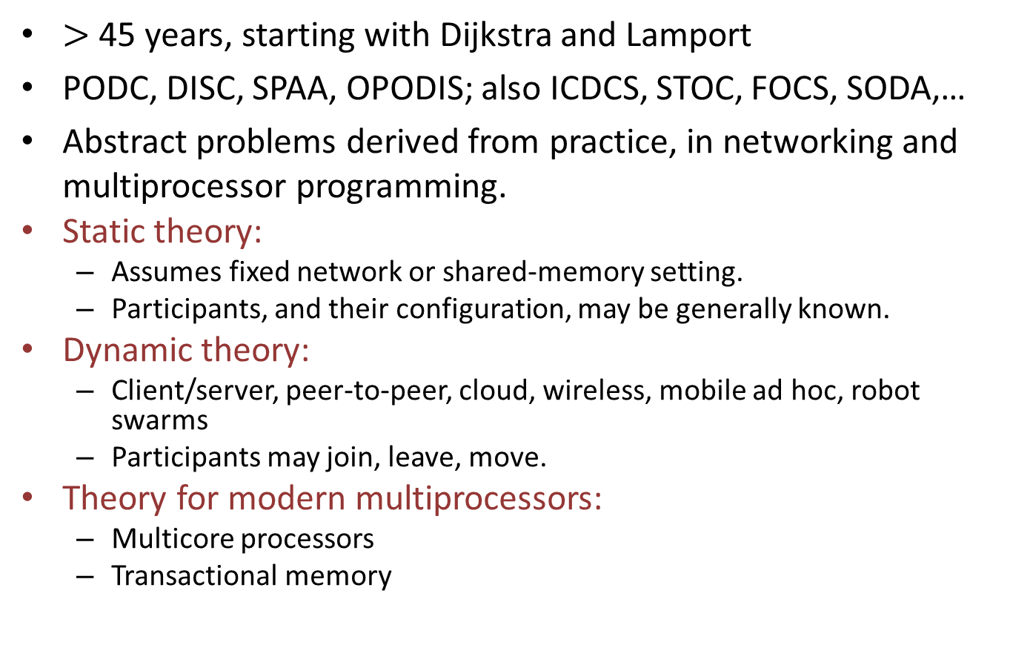
Distributed algorithms research
$>$ 45 years, starting with Dijkstra and Lamport
PODC, DISC, SPAA, OPODIS; also ICDCS, STOC, FOCS, SODA,…
Abstract problems derived from practice, in networking and multiprocessor programming.
Static theory:
Assumes fixed network or shared-memory setting.
Participants, and their configuration, may be generally known.
Dynamic theory:
Client/server, peer-to-peer, cloud, wireless, mobile ad hoc, robot swarms
Participants may join, leave, move.
Theory for modern multiprocessors:
Multicore processors
Transactional memory
Notes:
Distributed algorithms has been an active research area for around 45 years.
Also journals: Distributed Computing and many general theoretical CS and general CS journals.
Static theory is covered in standard textbooks, like mine and Attiya-Welch.
All three are active research areas.

Slide 5
Administrative info (Handout 1)
People and places
What is the course about?
Prerequisites
Math, systems, algorithms
Formal models of computation, e.g., automata:
Some courses (6.045, 6.840) study general theory of automata.
In 6.852, automata are tools, to model algorithms and systems.
Necessary, because the algorithms are complicated.
Source material
Books, papers
Course requirements
Readings
Problem sets
Given out every week, due every two weeks
Collaboration policy
Grading
Term projects:
Reading, theoretical research, or experimental research
Notes:
We need the formal models for clear understanding, because the algorithms are too complicated to understand clearly without this.
No exams.
Course grade calculation.

Slide 6
Topics (Handout 2)
Many different model assumptions:
Inter-process communication method:
Message-passing, shared memory.
Timing assumptions:
Synchronous (rounds)
Asynchronous (arbitrary speeds)
Partially synchronous (some timing assumptions, e.g., bounds on message delay, processor speeds, clock rates)
Failures:
Processor: Stopping, Byzantine
Communication: Message loss, duplication; Channel failures, recovery
Total system state corruption
Main organization: By timing model.
p₁
x₁
p₂
x₂
p_{n}
Notes:
Top-level organization of my book, and the course, is according to the timing model.
First synchronous, then asynchronous, then add timing assumptions.
Most of the course will deal with asynchrony.
For each timing model, we will consider different kinds of IPC and kinds of failures.

Slide 7
Topics
Synchronous model: Classes 1-8.
Basic, easy to use for designing algorithms.
Not realistic, but sometimes can be emulated in worse-behaved networks.
Impossibility results for synchronous networks carry over to worse networks.
Asynchronous: Classes 9-22.
More realistic, but harder to cope with.
Partially synchronous: In between. Probably won’t have time this year…
Special topics at the end: Failure detectors, self-stabilization, biological distributed algorithms.
Notes:
And dynamic and wireless algorithms at the very end.

Slide 8
In more detail…
Synchronous networks:
Model
Leader election (symmetry-breaking)
Network searching, spanning trees, Minimum Spanning Trees (MST’s)
Maximal Independent Sets (MIS’s), Coloring
Processor failures: Stopping and Byzantine failures
Fault-tolerant consensus: Algorithms and lower bounds
Other problems: Commit, approximate agreement, k-agreement
Modeling asynchronous systems (I/O automata)
Asynchronous networks, no failures:
Models and proofs
Leader election, network searching, spanning trees, revisited.
Synchronizers (for emulating synchronous algorithms in asynchronous networks)
Logical time, replicated state machines.
Stable property detection (termination, deadlock, snapshots).

Slide 9
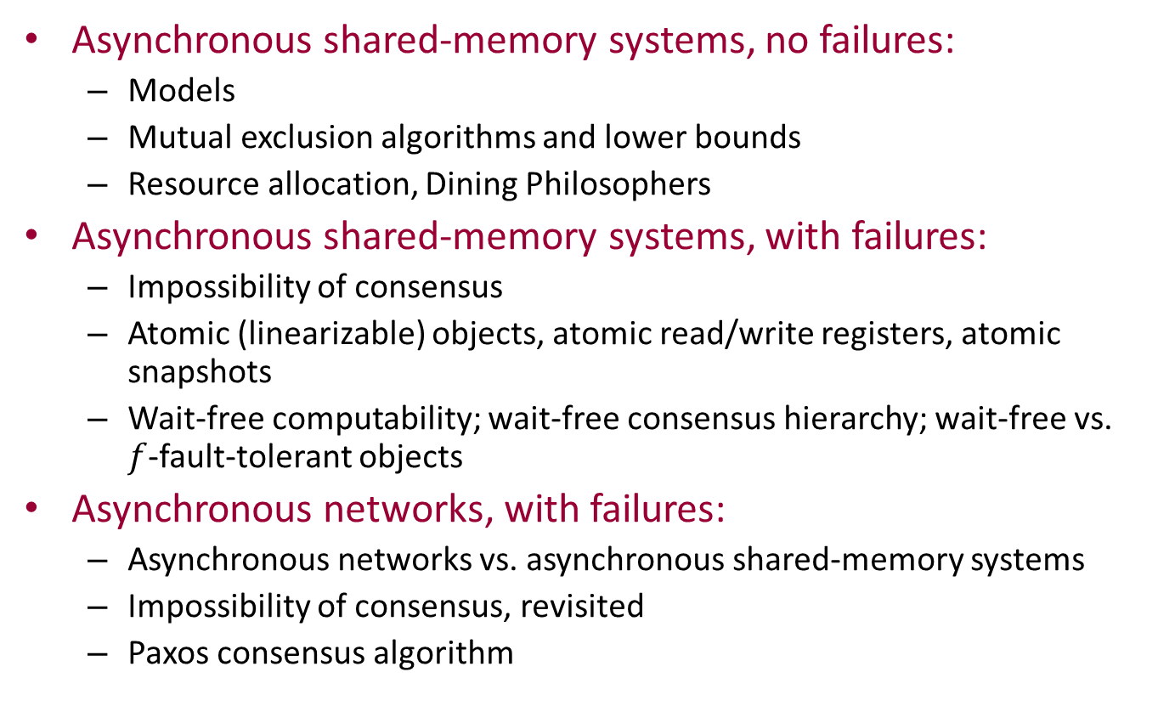
In more detail…
Asynchronous shared-memory systems, no failures:
Models
Mutual exclusion algorithms and lower bounds
Resource allocation, Dining Philosophers
Asynchronous shared-memory systems, with failures:
Impossibility of consensus
Atomic (linearizable) objects, atomic read/write registers, atomic snapshots
Wait-free computability; wait-free consensus hierarchy; wait-free vs. $f$-fault-tolerant objects
Asynchronous networks, with failures:
Asynchronous networks vs. asynchronous shared-memory systems
Impossibility of consensus, revisited
Paxos consensus algorithm

Slide 10
In more detail…
Failure detectors
Self-stabilizing algorithms
(Partially-synchronous systems and timing-based algorithms:
Models and proofs, timed I/O automata
Mutual exclusion, consensus
Clock synchronization)
(Distributed algorithms for dynamic networks:
Atomic memory
Virtual Nodes
Computing functions in dynamic networks)
Biological distributed algorithms
Social insect colony algorithms: Foraging, task-allocation, house-hunting
Notes:
We probably won’t get to the “partially synchronous” material, but we can provide some good references.
Likewise for the “dynamic” material.
Instead, this year, we’ll introduce some simple biological distributed algorithms.

Slide 11
Supplementary Readings (on line)
Other books:
[Attiya, Welch], general distributed algorithms
[Dolev], self-stabilization
[Peleg], local network computation
[Kaynar, Lynch, Segala, Vaandrager], interacting automata modeling for distributed algorithms/systems
Morgan Claypool monograph series on Distributed Computing Theory
Dijkstra Prize papers, 2000-2015
A variety of other interesting papers
Also check out proceedings for PODC, DISC, etc.

Slide 12
Now start the actual course…
Rest of today:
Synchronous network model
Leader election problem, in simple ring networks
Reading: Chapter 2; Sections 3.1-3.5.
Next Tuesday: Sections 3.6, 4.1-4.3
Questions?

Slide 13
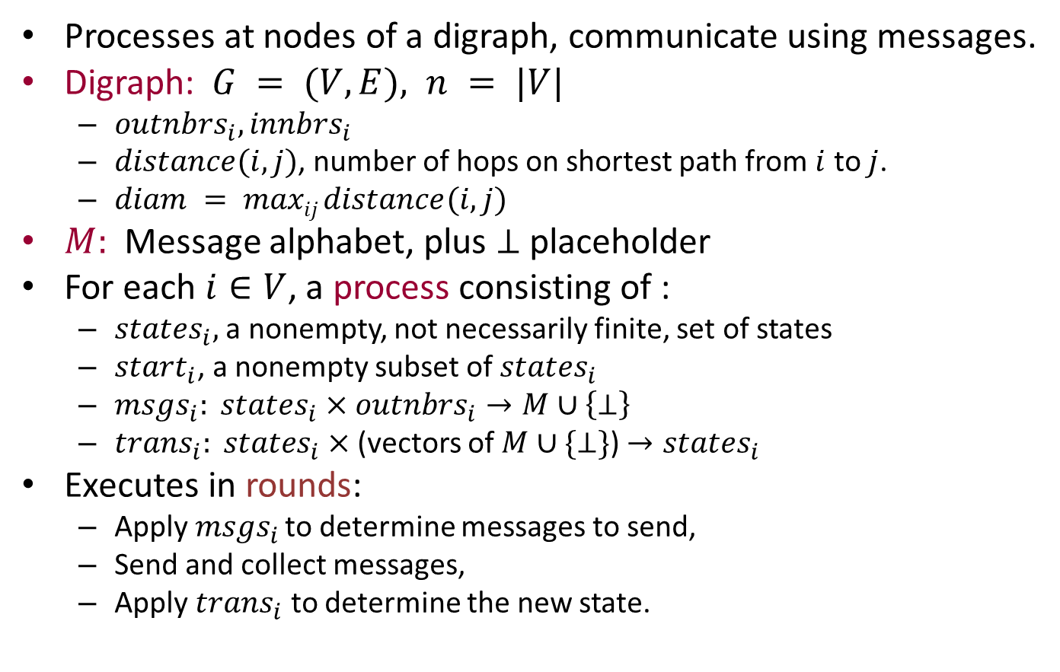
Synchronous network model
Processes at nodes of a digraph, communicate using messages.
Digraph: $G = (V,E), n = |V|$
$outnbrs_{i}, innbrs_{i}$
$distance(i,j)$, number of hops on shortest path from $i$ to $j$.
$diam = maxij distance(i,j)$
$M:$Message alphabet, plus $⊥$ placeholder
For each $i∈V$, a process consisting of :
$states_{i},$ a nonempty, not necessarily finite, set of states
$start_{i}$, a nonempty subset of $states_{i}$
$msgs_{i}: states_{i}×outnbrs_{i}→M∪\left\{⊥\right\}$
$trans_{i}: states_{i}×$(vectors of $M∪\{⊥\}$) $→states_{i}$
Executes in rounds:
Apply $msgs_{i}$ to determine messages to send,
Send and collect messages,
Apply $trans_{i}$ to determine the new state.
Notes:
The vectors are indexed by the in-nbrs.
Simple, but introduces some of the complexities of real distributed algorithms:
Concurrent activity
Inputs, outputs at many locations.
I’m glossing over the issue here of what kind of names the nodes know their neighbors by. In my 6.046 slides, I emphasized “port names”, to make clear that the names were purely local. I’ll do something similar here when I need this, but less formally.

Slide 14
Remarks
No restriction on amount of local computation.
Deterministic (a simplification).
Later, we will consider some complications:
Variable start times
Failures
Random choices
Can define “halting states”, but not used as accepting states as in traditional automata theory.
Inputs and outputs: Can encode in the states, e.g., in special input and output variables.

Slide 15
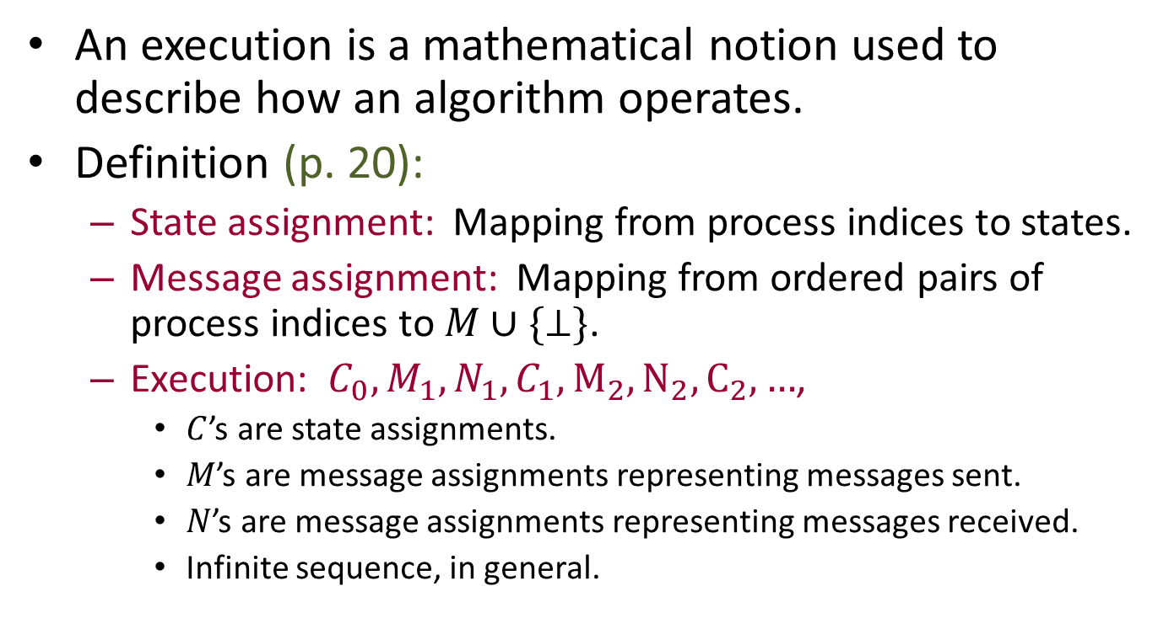
Executions
An execution is a mathematical notion used to describe how an algorithm operates.
Definition (p. 20):
State assignment: Mapping from process indices to states.
Message assignment: Mapping from ordered pairs of process indices to $M∪\{⊥\}$.
Execution: $C_{0},M_{1},N_{1},C_{1},M_{2},N_{2},C_{2},…$,
$C$’s are state assignments.
$M$’s are message assignments representing messages sent.
$N$’s are message assignments representing messages received.
Infinite sequence, in general.
Notes:
To talk precisely about “what happens” when the algorithm runs, we define a mathematical object called an “execution” and talk precisely about that.
In the general model, the sequences are infinite. But we often consider finite prefixes of the execution sequence, when we want to talk about finite behavior.

Slide 16
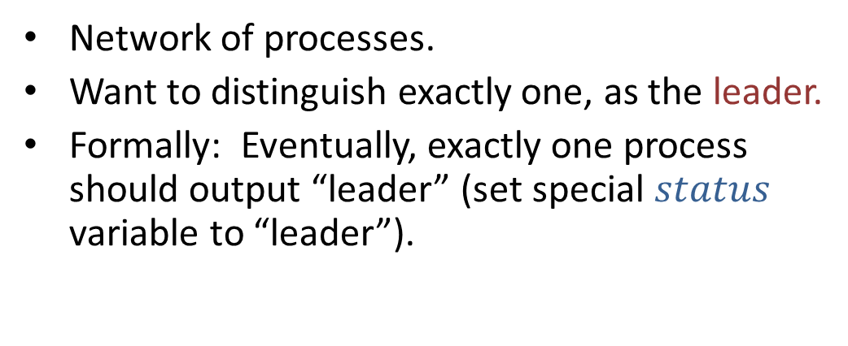
Leader election
Network of processes.
Want to distinguish exactly one, as the leader.
Formally: Eventually, exactly one process should output “leader” (set special $status$ variable to “leader”).
Motivation: Leader can take charge of:
Communication
Coordinating data processing
Allocating resources
Scheduling tasks
Coordinating consensus protocols
…
Notes:
Coordinate data processing: E.g., in commit protocols.

Slide 17
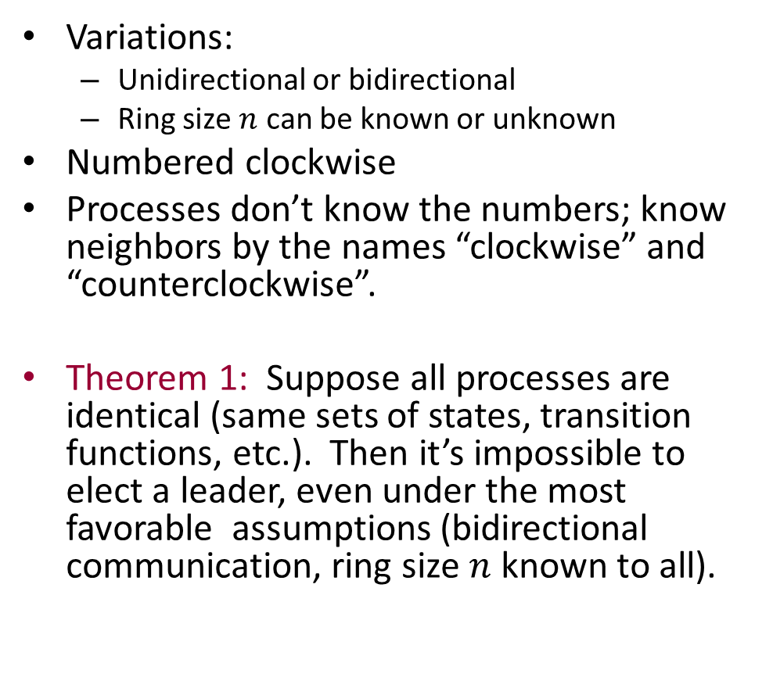
Simple case: Ring network
Variations:
Unidirectional or bidirectional
Ring size $n$ can be known or unknown
Numbered clockwise
Processes don’t know the numbers; know neighbors by the names “clockwise” and “counterclockwise”.
Theorem 1: Suppose all processes are identical (same sets of states, transition functions, etc.). Then it’s impossible to elect a leader, even under the most favorable assumptions (bidirectional communication, ring size $n$ known to all).
1
2
3
1
2
3
Notes:
Simple case, but still shows some of the key difficulties.
The numbers are just a convenience for us to talk about the algorithms. The processes don’t know them.

Slide 18
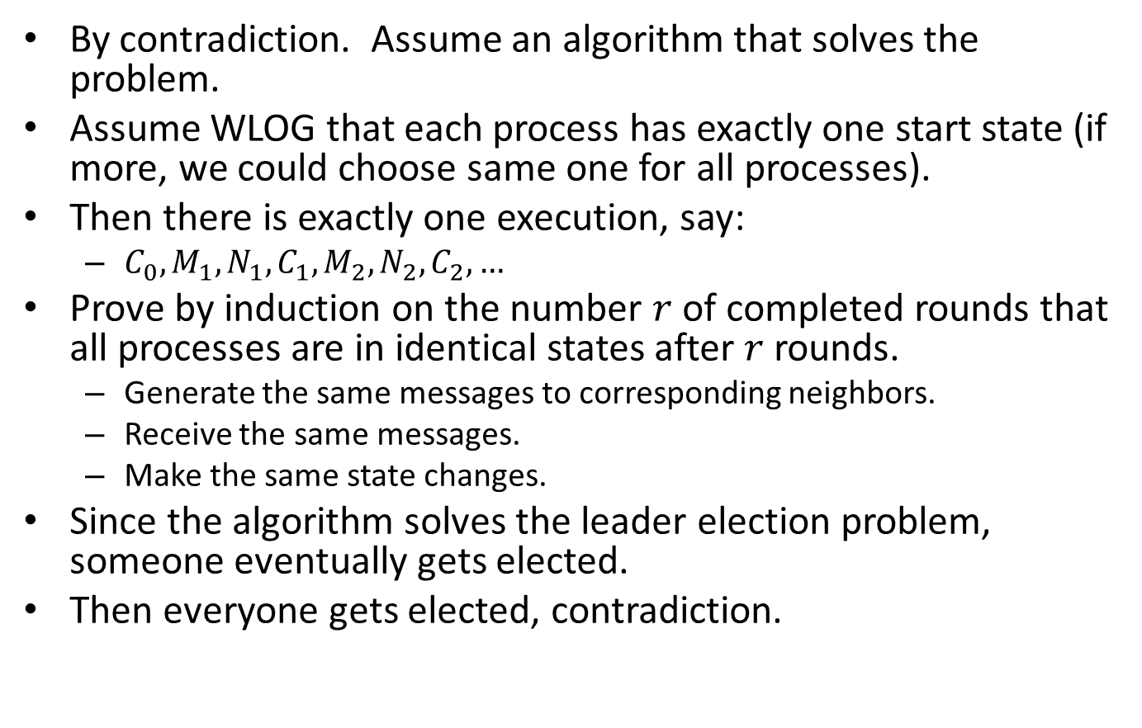
Proof of Theorem 1
By contradiction. Assume an algorithm that solves the problem.
Assume WLOG that each process has exactly one start state (if more, we could choose same one for all processes).
Then there is exactly one execution, say:
$C_{0},M_{1},N_{1},C_{1},M_{2},N_{2},C_{2},…$
Prove by induction on the number $r$ of completed rounds that all processes are in identical states after $r$ rounds.
Generate the same messages to corresponding neighbors.
Receive the same messages.
Make the same state changes.
Since the algorithm solves the leader election problem, someone eventually gets elected.
Then everyone gets elected, contradiction.
Notes:
If an algorithm has multiple start states, it’s supposed to work for all of them (that’s how nondeterminism is handled in distributed computing theory).

Slide 19
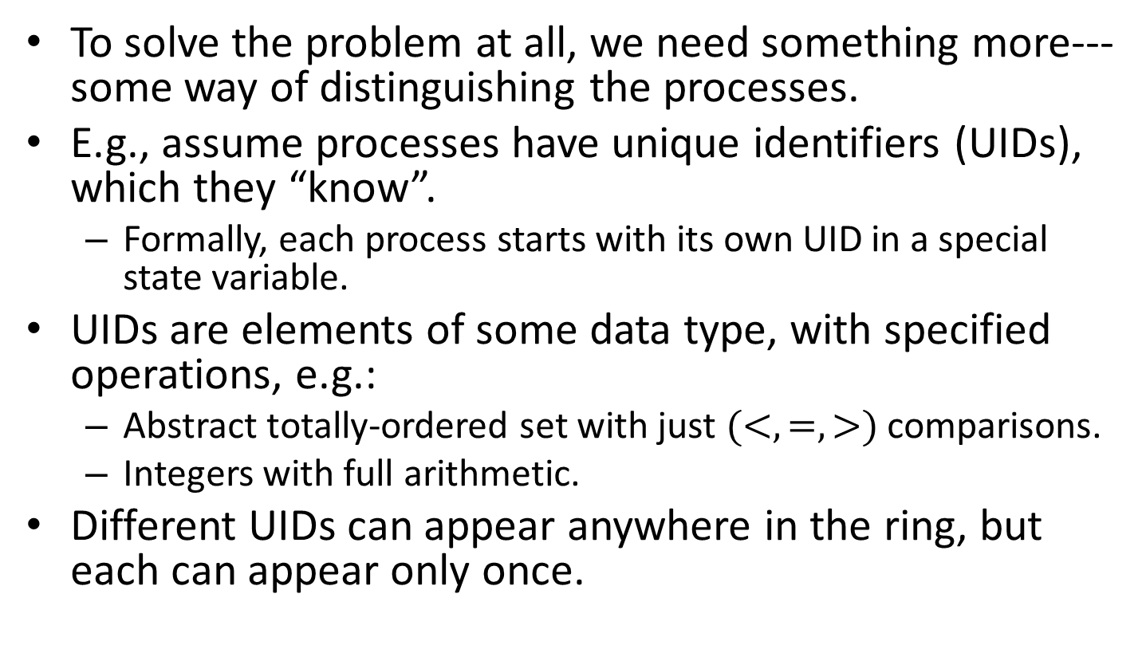
So we need something more…
To solve the problem at all, we need something more---some way of distinguishing the processes.
E.g., assume processes have unique identifiers (UIDs), which they “know”.
Formally, each process starts with its own UID in a special state variable.
UIDs are elements of some data type, with specified operations, e.g.:
Abstract totally-ordered set with just $(<, =, >)$comparisons.
Integers with full arithmetic.
Different UIDs can appear anywhere in the ring, but each can appear only once.

Slide 20
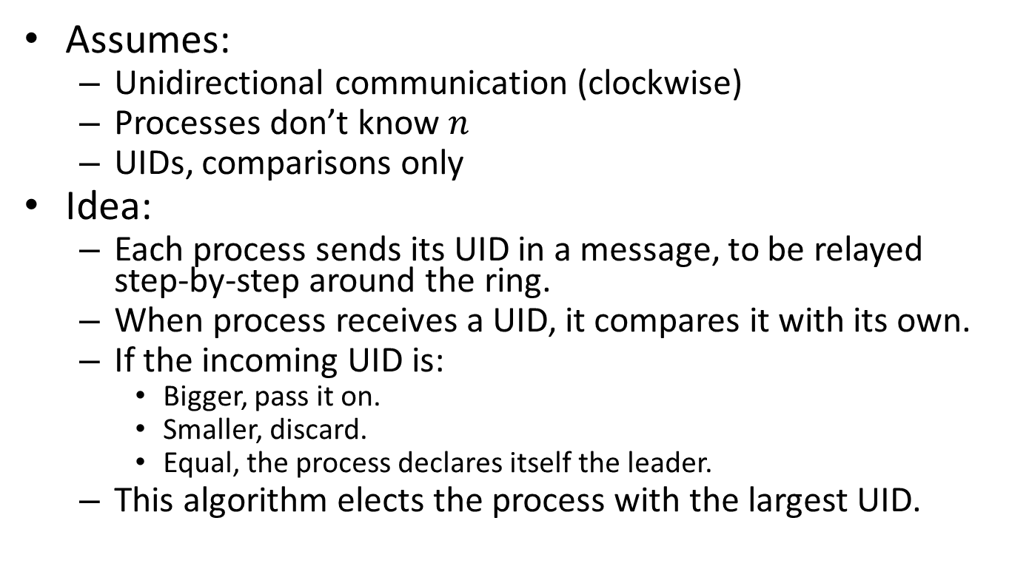
A basic algorithm [LeLann] [Chang, Roberts]
Assumes:
Unidirectional communication (clockwise)
Processes don’t know $n$
UIDs, comparisons only
Idea:
Each process sends its UID in a message, to be relayed step-by-step around the ring.
When process receives a UID, it compares it with its own.
If the incoming UID is:
Bigger, pass it on.
Smaller, discard.
Equal, the process declares itself the leader.
This algorithm elects the process with the largest UID.

Slide 21
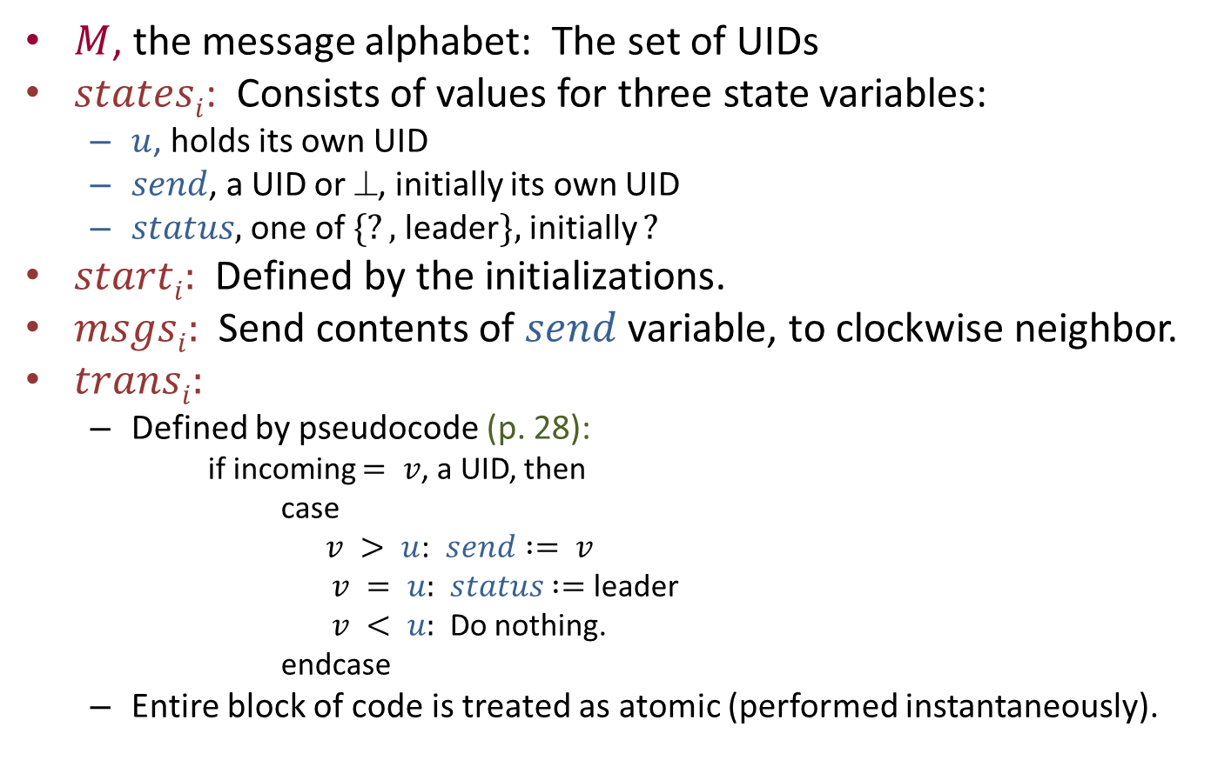
In terms of our formal model:
$M$, the message alphabet: The set of UIDs
$statesi$: Consists of values for three state variables:
$u$, holds its own UID
$send$, a UID or $$, initially its own UID
$status,$ one of $\{?,$leader$\},$initially $?$
$starti:$ Defined by the initializations.
$msgsi:$Send contents of $send$ variable, to clockwise neighbor.
$transi:$
Defined by pseudocode (p. 28):
if incoming $= v$, a UID, then
case
$v > u$: $send := v$
$v = u:$ $status$ $:=$ leader
$v < u:$Do nothing.
endcase
Entire block of code is treated as atomic (performed instantaneously).
Notes:
Program is designed to translate directly into the formal model.
Convention: For \bot, instead of actually sending, just don’t send anything.

Slide 22
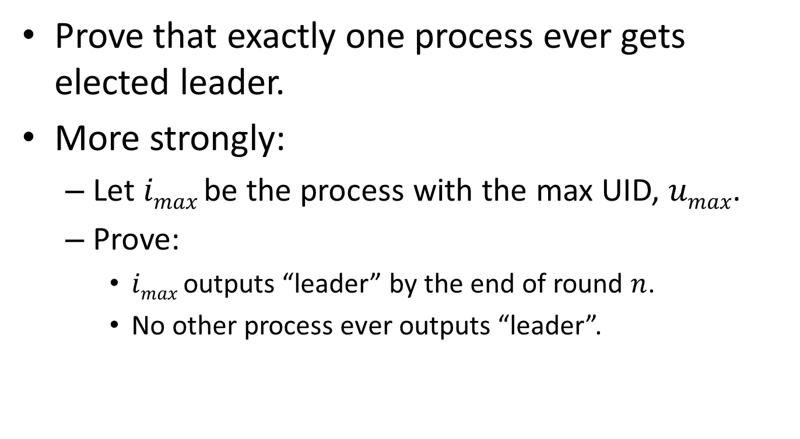
Correctness proof
Prove that exactly one process ever gets elected leader.
More strongly:
Let $imax$be the process with the max UID, $umax$.
Prove:
$imax$ outputs “leader” by the end of round $n$.
No other process ever outputs “leader”.
Notes:
We can do formal proofs because the algorithms are modelled formally in terms of state machines.

Slide 23
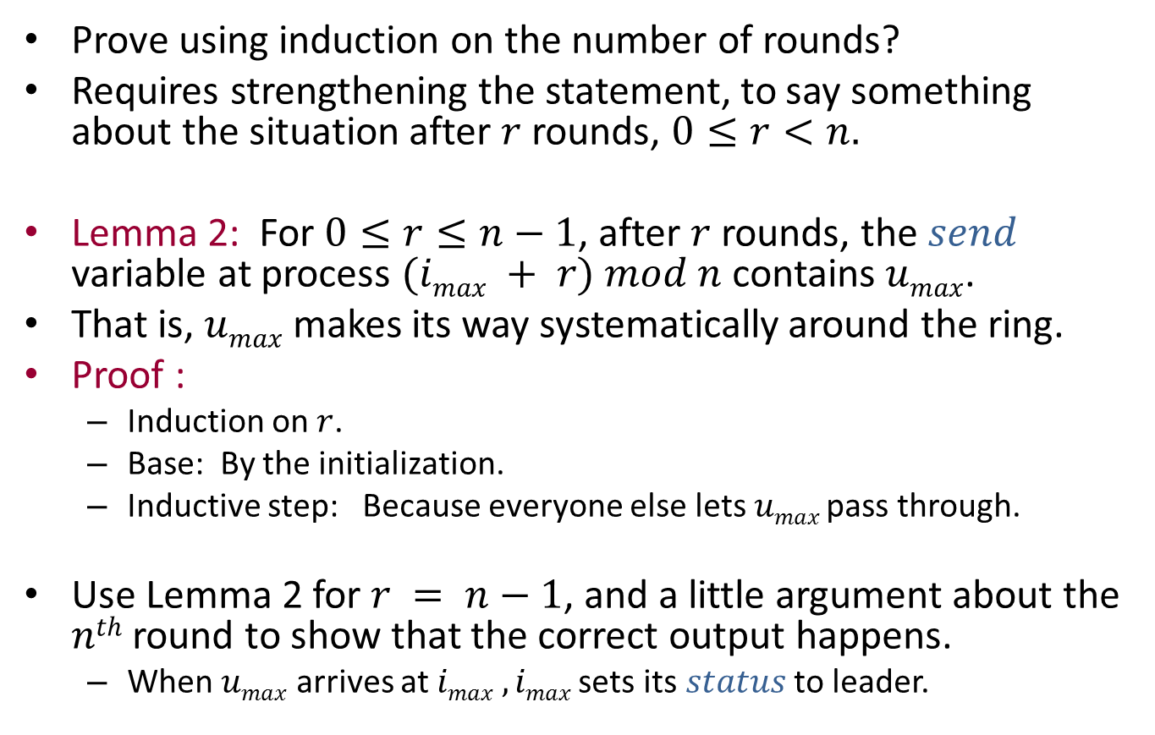
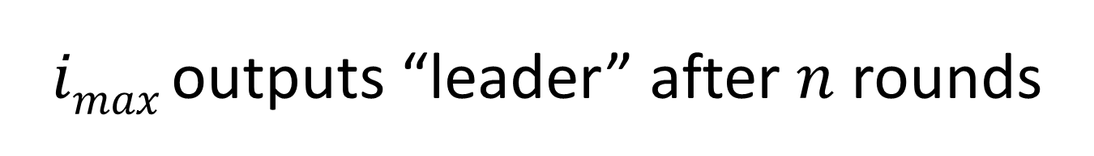
$imax$ outputs “leader” after $n$ rounds
Prove using induction on the number of rounds?
Requires strengthening the statement, to say something about the situation after $r$ rounds, $0≤r<n.$
Lemma 2: For $0≤r≤n−1$, after $r$ rounds, the $send$ variable at process $(imax + r) mod n$contains $umax$.
That is, $umax$makes its way systematically around the ring.
Proof :
Induction on $r$.
Base: By the initialization.
Inductive step: Because everyone else lets $umax$ pass through.
Use Lemma 2 for $r = n−1$, and a little argument about the $nth$ round to show that the correct output happens.
When $umax$ arrives at $imax , imax$sets its $status$ to leader.

Slide 24
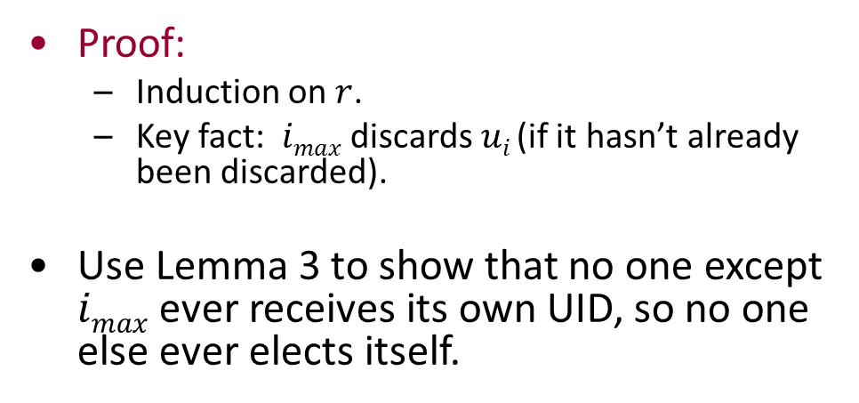
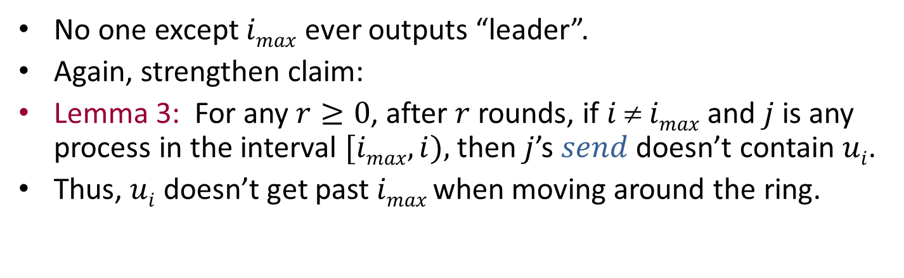
Uniqueness
No one except $imax$ ever outputs “leader”.
Again, strengthen claim:
Lemma 3: For any $r≥0$, after $r$ rounds, if $i  imax$and $j$is any process in the interval $[imax,i),$then $j$’s $send$ doesn’t contain $ui$.
Thus, $ui$ doesn’t get past $imax$when moving around the ring.
Proof:
Induction on $r$.
Key fact: $imax$ discards $ui$ (if it hasn’t already been discarded).
Use Lemma 3 to show that no one except $imax$ ever receives its own UID, so no one else ever elects itself.
i_{max}
j
i

Slide 25
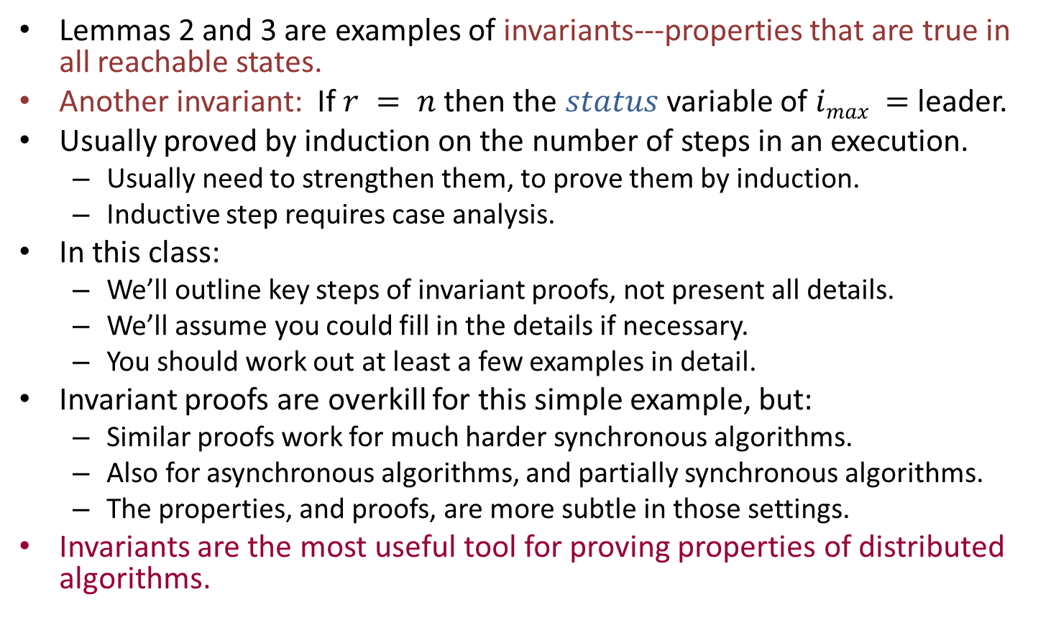
Invariant proofs
Lemmas 2 and 3 are examples of invariants---properties that are true in all reachable states.
Another invariant: If $r = n$then the $status$ variable of $imax =$ leader.
Usually proved by induction on the number of steps in an execution.
Usually need to strengthen them, to prove them by induction.
Inductive step requires case analysis.
In this class:
We’ll outline key steps of invariant proofs, not present all details.
We’ll assume you could fill in the details if necessary.
You should work out at least a few examples in detail.
Invariant proofs are overkill for this simple example, but:
Similar proofs work for much harder synchronous algorithms.
Also for asynchronous algorithms, and partially synchronous algorithms.
The properties, and proofs, are more subtle in those settings.
Invariants are the most useful tool for proving properties of distributed algorithms.
Notes:
After n rounds, the leader knows it’s the leader.
Technically, this new example assumes that r is in the state.
Proofs of invariants can be done using interactive theorem-provers; they are so stylized, lend themselves to automated support.

Slide 26
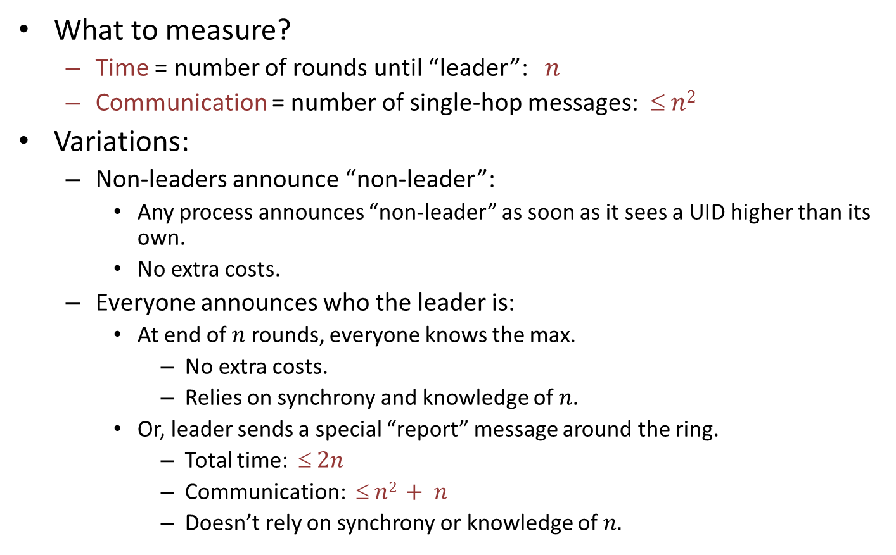
Complexity bounds
What to measure?
Time = number of rounds until “leader”: $n$
Communication = number of single-hop messages: $ n2$
Variations:
Non-leaders announce “non-leader”:
Any process announces “non-leader” as soon as it sees a UID higher than its own.
No extra costs.
Everyone announces who the leader is:
At end of $n$ rounds, everyone knows the max.
No extra costs.
Relies on synchrony and knowledge of $n$.
Or, leader sends a special “report” message around the ring.
Total time: $ 2n$
Communication: $ n2 + n$
Doesn’t rely on synchrony or knowledge of $n.$
Notes:
Discussion of not relying on synchrony is getting ahead of ourselves a bit---we haven’t studied asynchronous algorithms yet. Later.

Slide 27
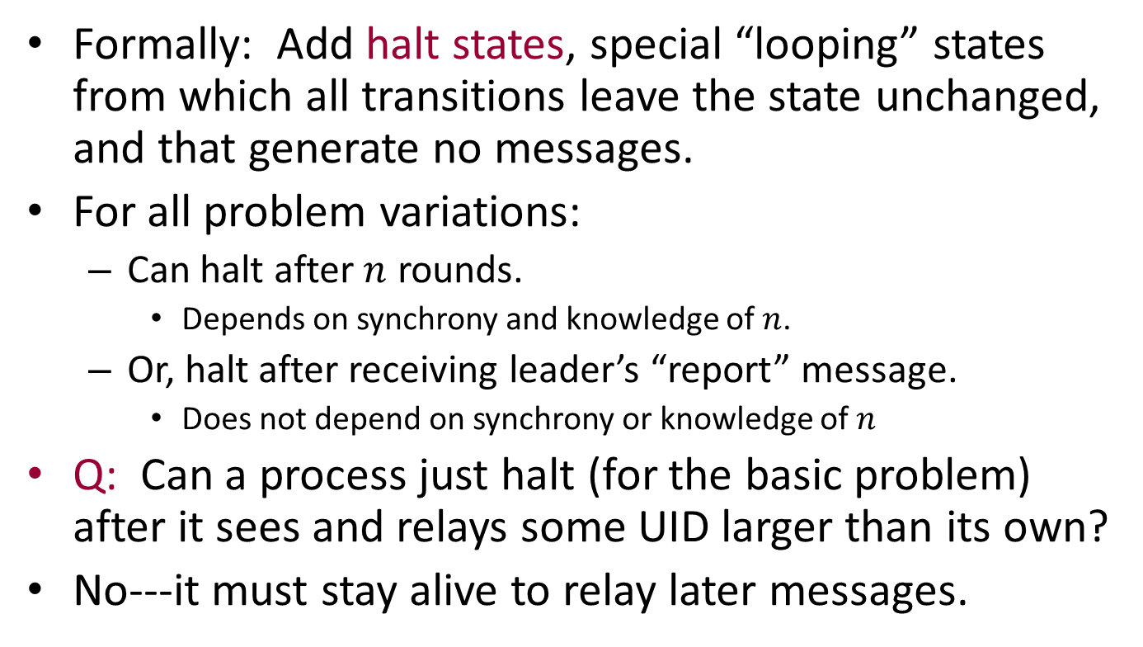
Halting
Formally: Add halt states, special “looping” states from which all transitions leave the state unchanged, and that generate no messages.
For all problem variations:
Can halt after $n$ rounds.
Depends on synchrony and knowledge of $n$.
Or, halt after receiving leader’s “report” message.
Does not depend on synchrony or knowledge of $n$
Q: Can a process just halt (for the basic problem) after it sees and relays some UID larger than its own?
No---it must stay alive to relay later messages.

Slide 28
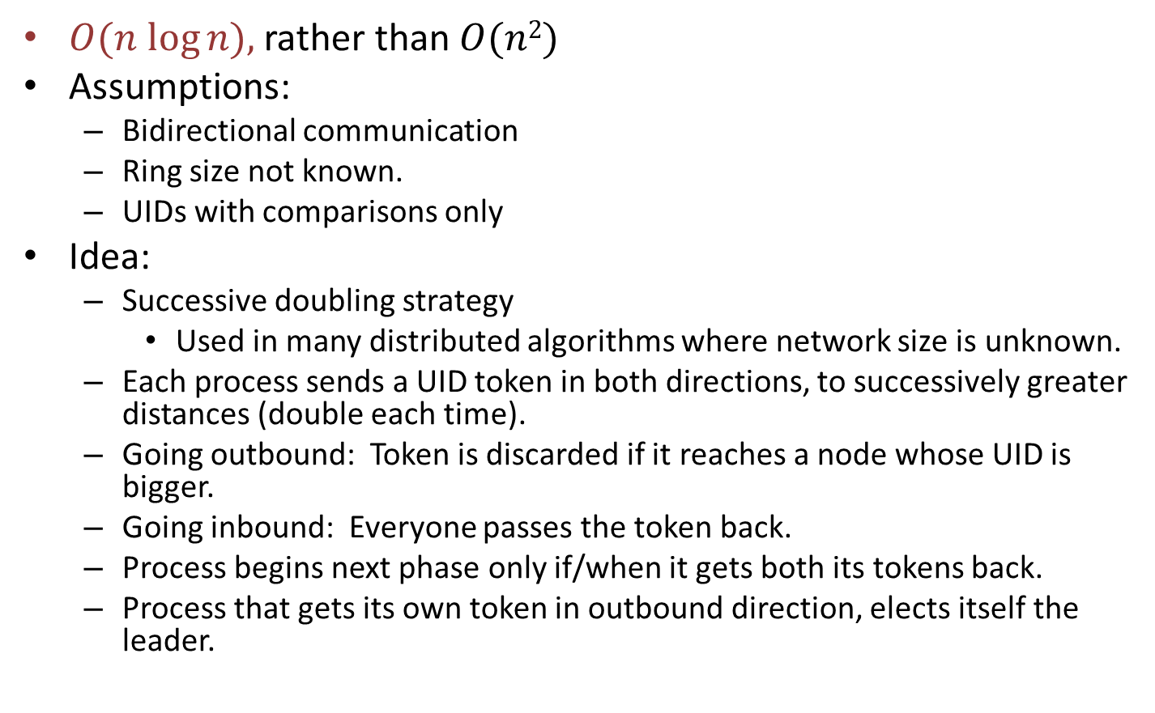
Reducing the communication complexity [Hirschberg, Sinclair]
$O(n log⁡n),$rather than $O(n2)$
Assumptions:
Bidirectional communication
Ring size not known.
UIDs with comparisons only
Idea:
Successive doubling strategy
Used in many distributed algorithms where network size is unknown.
Each process sends a UID token in both directions, to successively greater distances (double each time).
Going outbound: Token is discarded if it reaches a node whose UID is bigger.
Going inbound: Everyone passes the token back.
Process begins next phase only if/when it gets both its tokens back.
Process that gets its own token in outbound direction, elects itself the leader.

Slide 29
In terms of formal model:
Needs local process description.
Involves bookkeeping, with hop counts.
LTTR (p. 33)
Notes:
This is a global description. To express this in the form allowed by the model, must write in terms of local process descriptions.

Slide 30
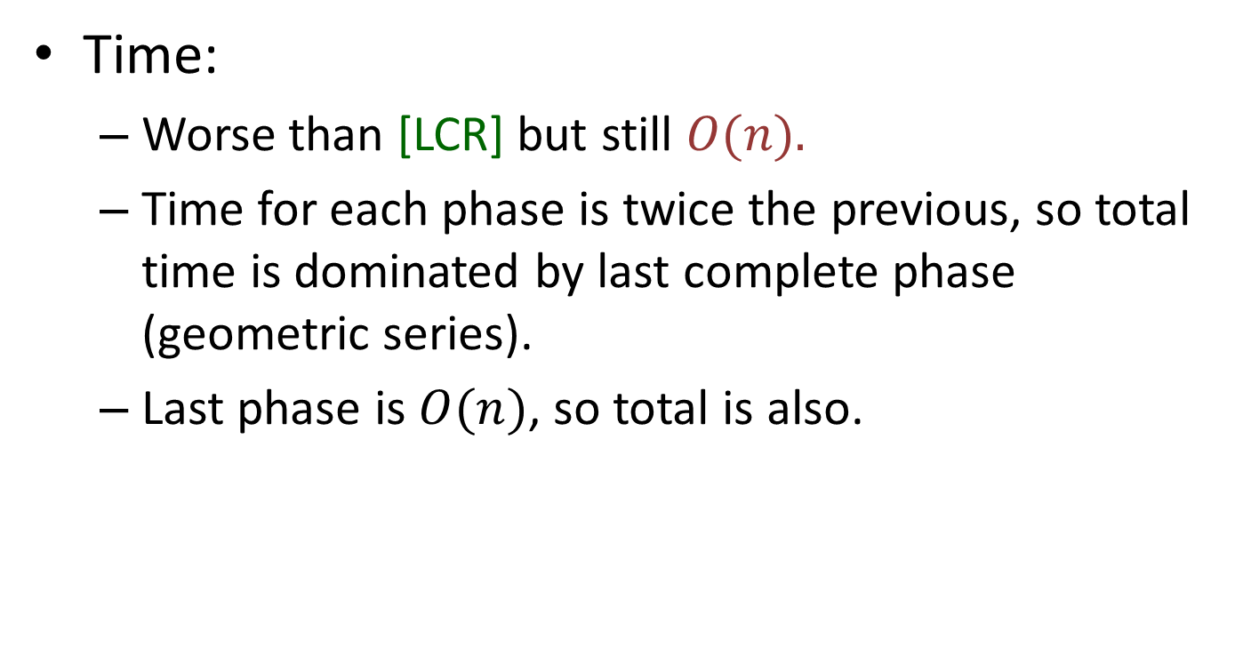
Complexity bounds
Time:
Worse than [LCR] but still $O(n).$
Time for each phase is twice the previous, so total time is dominated by last complete phase (geometric series).
Last phase is $O(n)$, so total is also.

Slide 31
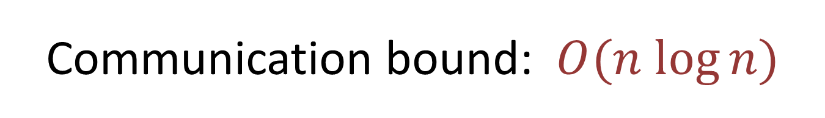
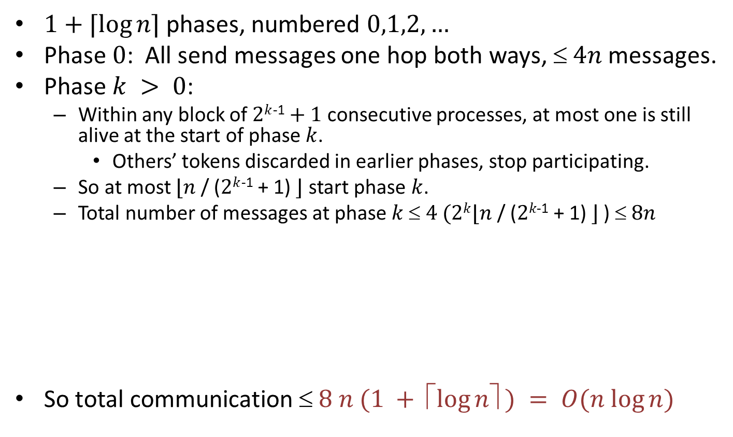
Communication bound: $O(n log⁡n)$
$1+⌈\log{n⌉}$phases, numbered $0,1,2,…$
Phase $0$: All send messages one hop both ways, $ 4n$messages.
Phase $k > 0$:
Within any block of $2k$⁻¹$+ 1$consecutive processes, at most one is still alive at the start of phase $k$.
Others’ tokens discarded in earlier phases, stop participating.
So at most $⌊n$ / ($2k$⁻¹ + 1) $⌋$ start phase $k$.
Total number of messages at phase $k $ $4 (2k⌊n\text{ / (}2k\text{−1}\text{ + 1) }⌋$ ) $ 8n$
So total communication $ 8 n (1 + ⬆log⁡n ) = O(n log⁡n)$
Distance
Out and back,
both directions
Notes:
Assuming that in phase k messages travel distance 2^k.
Ignoring roundoffs.

Slide 32
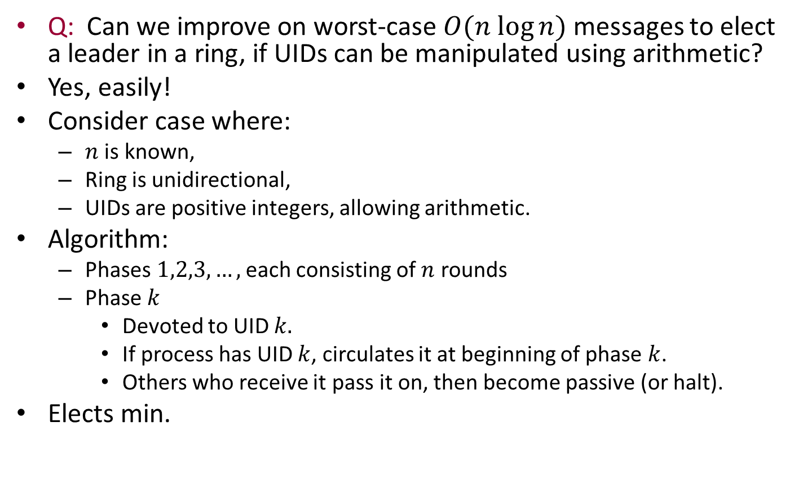
Non-comparison-based algorithms
Q: Can we improve on worst-case $O(n log⁡n)$messages to elect a leader in a ring, if UIDs can be manipulated using arithmetic?
Yes, easily!
Consider case where:
$n$ is known,
Ring is unidirectional,
UIDs are positive integers, allowing arithmetic.
Algorithm:
Phases $1,2,3,…,$each consisting of $n$ rounds
Phase $k$
Devoted to UID $k.$
If process has UID $k$, circulates it at beginning of phase $k$.
Others who receive it pass it on, then become passive (or halt).
Elects min.

Slide 33
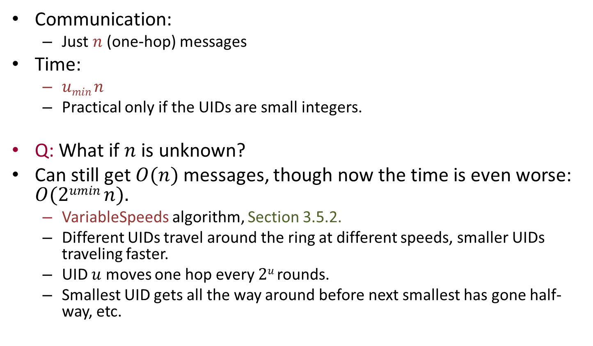
Complexity bounds
Communication:
Just $n$ (one-hop) messages
Time:
$umin n$
Practical only if the UIDs are small integers.
Q: What if $n$ is unknown?
Can still get $O(n)$ messages, though now the time is even worse: $O(2umin n).$
VariableSpeeds algorithm, Section 3.5.2.
Different UIDs travel around the ring at different speeds, smaller UIDs traveling faster.
UID $u$ moves one hop every $2u$ rounds.
Smallest UID gets all the way around before next smallest has gone half-way, etc.

Slide 34
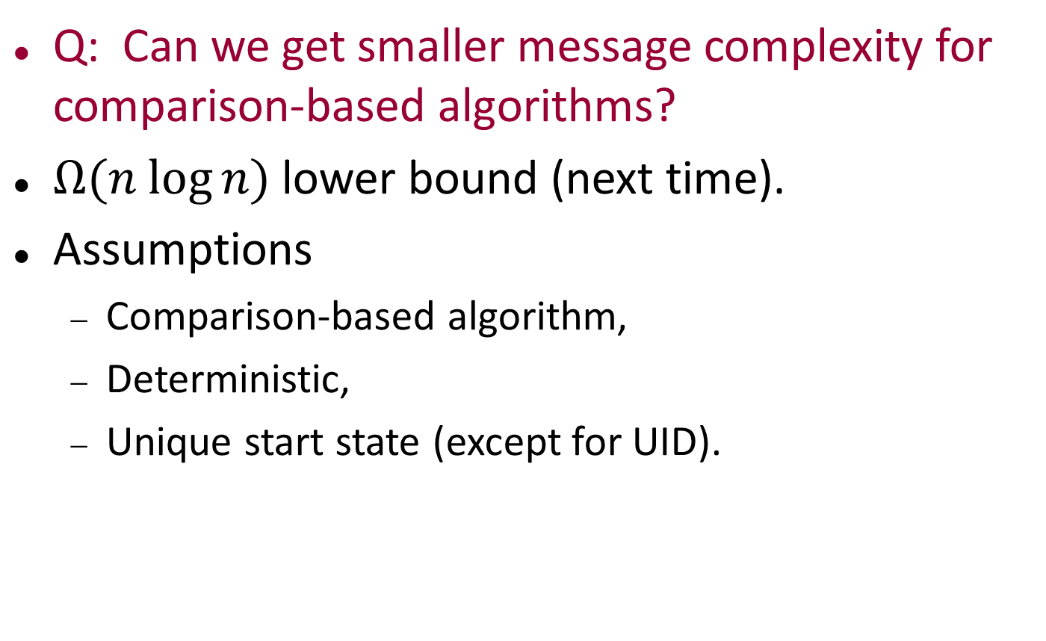
Lower bound
Q: Can we get smaller message complexity for comparison-based algorithms?
$Ω(n log⁡n)$lower bound (next time).
Assumptions
Comparison-based algorithm,
Deterministic,
Unique start state (except for UID).

Slide 35
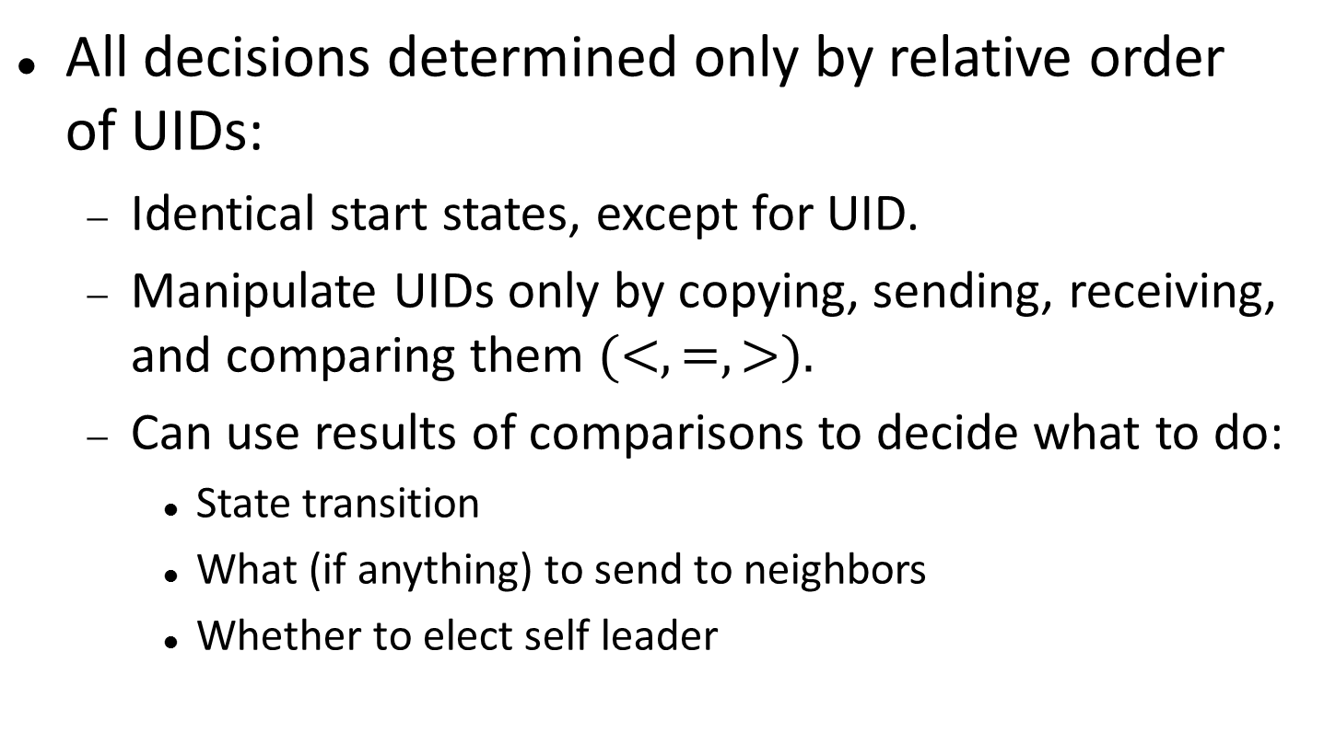
Comparison-based algorithms
All decisions determined only by relative order of UIDs:
Identical start states, except for UID.
Manipulate UIDs only by copying, sending, receiving, and comparing them $(<, =, >).$
Can use results of comparisons to decide what to do:
State transition
What (if anything) to send to neighbors
Whether to elect self leader
Notes:
Formalized a little better in book; done carefully in research paper.

Slide 36
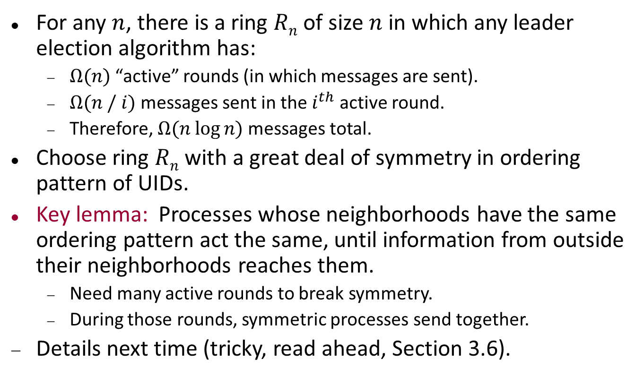
Lower bound proof: Overview
For any $n$, there is a ring $Rn$ of size $n$ in which any leader election algorithm has:
$Ω(n)$ “active” rounds (in which messages are sent).
$Ω(n / i)$messages sent in the $i^{th}$active round.
Therefore, $Ω(n log⁡n)$messages total.
Choose ring $Rn$ with a great deal of symmetry in ordering pattern of UIDs.
Key lemma: Processes whose neighborhoods have the same ordering pattern act the same, until information from outside their neighborhoods reaches them.
Need many active rounds to break symmetry.
During those rounds, symmetric processes send together.
Details next time (tricky, read ahead, Section 3.6).
Notes:
In an active round, at least one process i sends. So all that are symmetric with i (symmetry not yet broken) will send also.

Slide 37
Next time…
Lower bound on communication for comparison-based leader election algorithms in rings, in detail.
Basic computational tasks in general synchronous networks:
Leader election, breadth-first search, shortest paths, broadcast and convergecast.
Readings:
Sections 3.6, 4.1-4.3.

